Slide 1
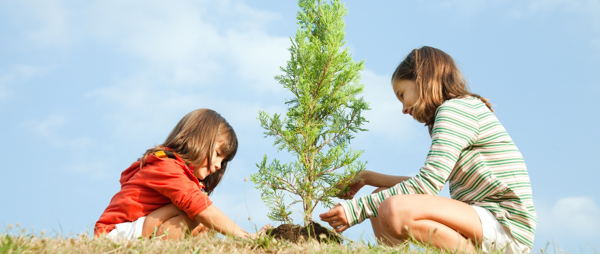
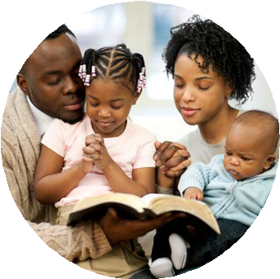
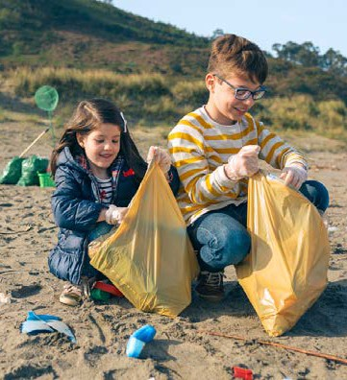
Global Children's Day
March 18, 2023
Love Is A Verb
Memory Verse
"Therefore, as we have opportunity, let us do good to all people, especially to those who belong to the family of believers," (Galatians 6:10, NIV).
“Carry each other's burdens, and in this way you will fulfill the law of Christ.” We were never meant to do life alone. We need the love and care of others, as much as we are needed by others in the same ways," (Galatians 6:2, NIV).
“Whoever is kind to the poor lends to the LORD, and he will reward them for what they have done,” (Proverbs 19:17, NIV).
“And do not forget to do good and to share with others, for with such sacrifices God is pleased,” (Hebrews 13:15, NIV).
“God is not unjust; he will not forget your work and the love you have shown him as you have helped his people and continue to help them,” (Hebrews 6:10, NIV).
Take time to memorize God's word and His promises this week and be blessed with the mandate of love!
Introduction
This resource is created for use as a worship program for children on Global Children's Sabbath or on March 18, 2023. The theme chosen for this year's Global Children's Day is "Love Is A Verb."
God needs caring and kind people continually to demonstrate His loving and caring character. God has chosen everyone, including young boys and girls to demonstrate this character of His and Global Children's Day has given us opportunity to be intentional in reflecting His love and care to those around us.
Our primary focus for Bible stories is based on 2 Kings 5:1-14 which is about the Little maid who had faith in God and a deep concern for Naaman's well- being. This led her to share and witness God's power and miraculous healing in Naaman's helpless health condition. Mrs. Ellen White emphasizes strongly that "Parents, your children should be your helping hand, increasing your power and ability to work for the Master. Children are the younger members of the Lord’s family. They should be led to consecrate themselves to God … They should be trained to help in various lines of unselfish service. Do not allow your children to be hindrances. With you, the children should share spiritual as well as physical burdens. By helping others, they increased their own happiness and usefulness,” (AH, p. 485.3)

Slide 2
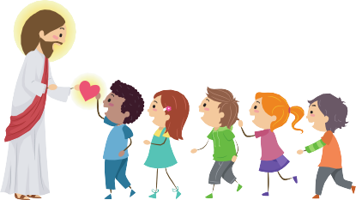
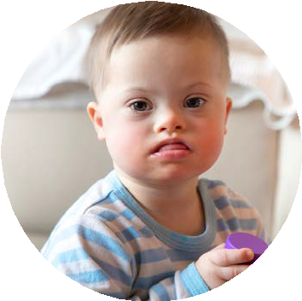
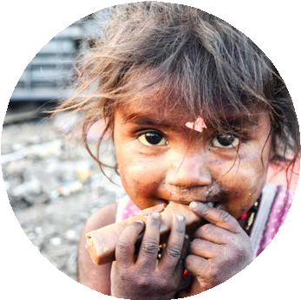
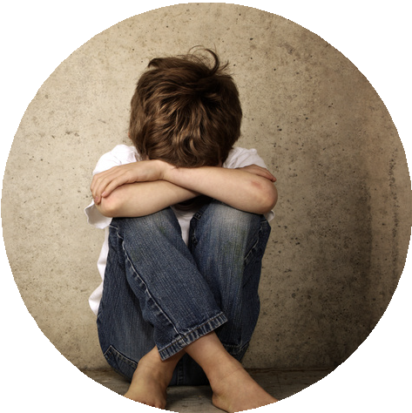
G O D ' S P E O P L E A R E C A R I N G
FEATURE TALK
People often focus on their own needs more than those around them. Jesus 's ministry on earth involved most of his time caring for those in needs. We learn from the Bible how he cared for the Samaritan women at the well that he had to stop to meet and transform her life when everyone gave her their cold shoulders (John 4:1-42). Jesus also cared for an insecured tax collector, Zachaeous, who tried to acquire wealth instead of desirable character as to feel equal in worth with his neighbors, but Jesus instead, expressed His genuine care and took time to dine at this man in order to get to know him personally and fellowship with him (Luke 19:1-10 ). And just before He died on the cross, Jesus cared so much for those who cared for Him; He made sure that there was someone who would care for his birth mother, Mary, after His death. Thus, he entrusted her to John to care for her on his behalf (John 19:25-27). When we care for someone, it really shows that we are Jesus's disciples since we have learned from Him.
There might be a lonely child in your neighborhood that needs your kind friendship, appreciation, or inclusivity while you are playing with other children at the playground.
At church, there are also bees that you could do to serve and witness with your talents. And to the larger community, there might be a need to
recycle waste, protect environment,and keep the park clean. Planting trees show a lot of your care and concern for the future generations.
All these needs are The need for a person varies from another. One might need physical support while another requires emotional support depending on their situations.
The suggested list below are some of those whom we could identify as people in need and they need our kind attention and caring acts:
Orphans
Single parent-family homes
Juveniles
Special needs people
Homeless individuals
Nursing home dwellers
Abandoned or street children
Refugees’ children and families
Poor and underprivileged families
A new neighbor who just moved in
It is not hard to recognize people needs. At home, you could easily identify the needs around the house and how you could ease your parents' daily routine and work at home. You could do something to assist your mom or dad such as doing house chores, closing the garage, turning off the TV or light when it is not in use, or do the dishes without being told. At school, there might be someone who needs you to assist them in their assignments and classwork and a classmate might need an encourager to study diligently.
THINK FURTHER
How can you help each category of people with specific needs? You may share one thing that you think would You may share one thing that you could do to ease their challenges and show that you care.

Slide 3
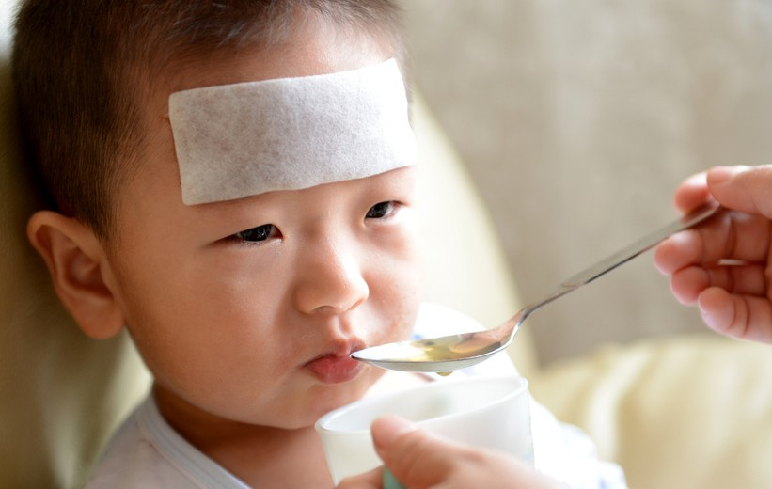
·
will bring joy to them and this includes your grandparents too as they might be living far from you.
6. Share your meaningful writing. People love to be appreciated. Whenever you are given a gift or being helped in some ways. Words expressed could fade in time but the hand-written thank you note will stick around.
HOW CAN YOU CARE FOR OTHERS IN A MEANINGFUL WAY
7. Share your personalized gift. Giving a gift is a good practice; however, it is meaningful to give a personalized gift. You could find personalized gifts that are inexpensive, but it is useful. Giving a practical gift is preferred; it is something that is useful and something that he or she needs.
1. Share your gift of time. When a person loses a family member or face some unfortunate circumstances with natural disasters, our visit would bring much encouragement to them. Being available when people need emotional support is very meaningful to them.
8. Make known your gratitude. Give recognition to those who deserve your gratitude. Learning to appreciate others need to be a pattern of our habit and mindset as we do appreciate God. Giving a recognition to someone also help reinforce his or her desirable behaviors.
·2. Share your friendship. If you see a neighbor just moved in a he has no one to play with, you may welcome him or her and befriend with the new child on the block. Being good friend is one of the most powerful ways of sharing and caring.
9. Share God’s love. Sharing the good news of God is about witnessing. All faithful followers of Christ are on the mission. We share things about God because we believe that knowing God and follow Him is the only way to attain the gift of salvation. Everyone deserves to be saved by God’s grace.
·3. Share your effort. We have seen from the pandemic how it could severely impact people’s health. Some people could be sick for days or weeks. Thus, their laundry could be left undone, and their house could be left uncleaned. Due to aging factor, the elderly would have less physical strength to perform simple tasks or chores that they used to do them efficiently at home. Recognize their needs and help to clean and wash their clothes would be a great help to them.
·
4. Share your genuine concern. When someone is sick, they are emotionally down and physically weak, presenting Get Well Soon cards will help cheer them up as they know that you care.
·5. Share your kind message. Covid-19 patients are often not allowed to be visited and pray for face to face. What you could do to get in touch with them is to either call or text. Wishing them to get well soon or praying with them are very powerful way of reaching out to them. Calls and texts should be done on a regular basis with our loved ones when we live separately or far away from each other. Letting someone know and speak to them via phone.

Slide 4
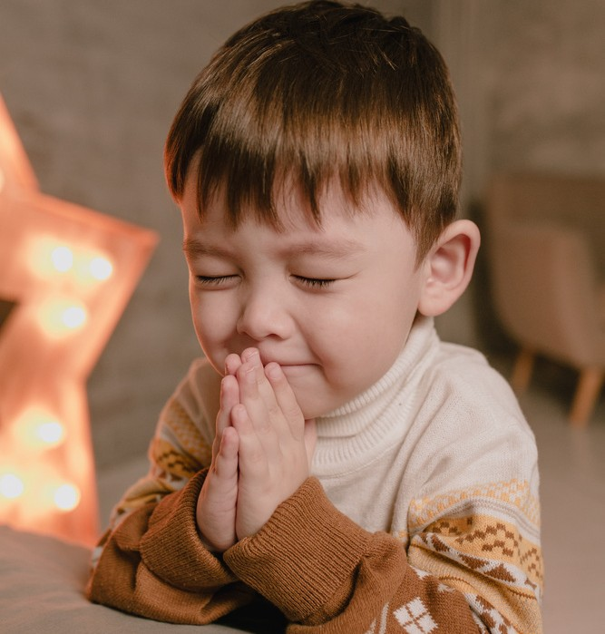
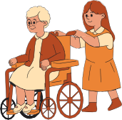
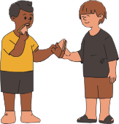
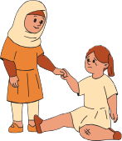
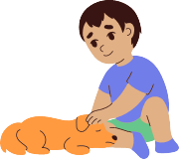
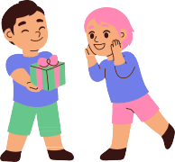
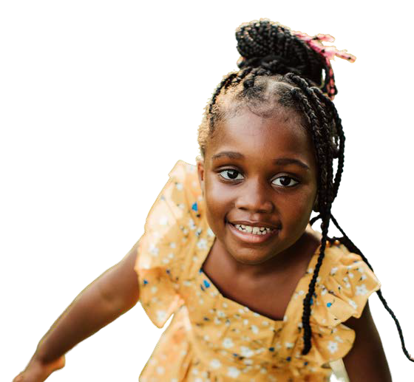
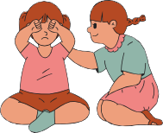
ACTIVITY FOR CHILDREN
Discuss with someone and share how a child is kind and caring in each picture.
YES
"And I will make of you a great nation, and I will bless you and make your name great, so that you will be a blessing. 3 I will bless those who bless you, and him who dishonors you I will curse, and pin you all the families of the earth shall be blessed," (Genesis 12:2-4, NIV)
"God blesses us, not only to keep gifts and joy to ourselves but also to use them to bless others."
Additional Activity
After the sharing is done for each picture, you may think of a kind and helpful act that you would do this coming week. Prioritize them in chronological order by writing number 1 being the first thing to do this coming week in the circle and writing number 6 being the last thing that you plan to do this coming week.

Slide 5
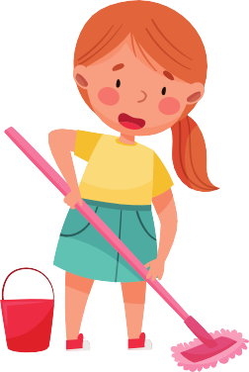
(*Naaman slowly walks in and act according to the sermon script.)
The Bible tells us about a man named Naaman. Naaman was the commander of the army of Syria. The king of Syria thought very highly of him because he was a brave solider and had led the army to many battles and through his leadership, many victories were gained. With his great accomplishments, the king and his people were very proud of him. Naaman, however, could not feel fully confident and good about himself; there was something that he was not proud of – he had leprosy (2 Kings 5:1).
SERMON: THE CARING LITTLE MAID
2 Kings 5:1-14
For children who do not know how this disease could impact a person, let me share with you some information about leprosy. It is an infection caused by slow-growing bacteria called Mycobacterium leprae. It can affect the nerves, skin, eyes, and lining of the nose (nasal mucosa). With early diagnosis and treatment, the disease can be cured. However, if left untreated, the nerve damage can result in crippling of hands and feet, paralysis, and blindness.
(*Scene: Naaman’s House with Table and Chairs.) (*Participatns: Naaman, Little Maid, Naaman's wife dressed with the costume representing bible times)
During the time of Naaman, leprosy was still an incurable disease. Nobody knew about the cause of it nor how to cure it because it was only much later that medication for treating leprosy was discovered. Also, during that time, when someone fell ill, it was often understood as God being unhappy with the person who grievously sinned and that He had to punish him or her. Having said, you could imagine how Naaman must have felt. He was being praised so much by those around him and even the King of the land admired him greatly. He had accepted all the honor and glory, but he was being defeated helplessly with the disease that invaded his body and killing him slowly.
Have you ever wondered, why you were you born? What was God thinking and having in mind when He created you? If you have ever done that, you are not alone. When I was young, I kept wondering about things around me; I did not really understand why people must be born and then would eventually die. I used to think it was a waste of time and everything.
It takes years for each of us to grow physically in width and length. We must have eaten a lot of food to grow this size The average life expectancy for an American is 78.8 years — that means that by the time we die, we've likely consumed about 73,646 pounds of food. That's basically digesting six elephants over the course of a lifetime! We also spend a lot of time studying and doing homework. And you know, school fees and supplies, all these did not come cheap. These have been provided and worked hard for by our parents or our family.
(*A servant girl is pushed into the center of the stage and Naaman receives her kindly and introduce to His wife who walks in from the other end of the stage. She kindly approves of her stay and begins telling her on what to do around the house.)
Soon later, in one of the Syrian army’s raids, they captured a young girl from Israel, and she was given to Naaman’s wife to serve as her servant. People talked a lot of Naaman and how important he was as the commander of the king’s army. However, if we read the scripture, there is someone more important than Naaman and his healing experience. More importantly to me, this portion of the Bible introduces us to a little girl who was not even given a name, but she played a vital role in leading Naaman to experience God’s healing miracle.
Romans 8:28 emphasizes, “those who love God all things work together for good, for those who are called according to His purpose.” We are reminded here that each one of us were born for a purpose, and it is very important that we discover it since young. In doing so, we will be able to find our sense of purpose in every situation as thrive on with hope, faith and live with a purposeful life.

Slide 6
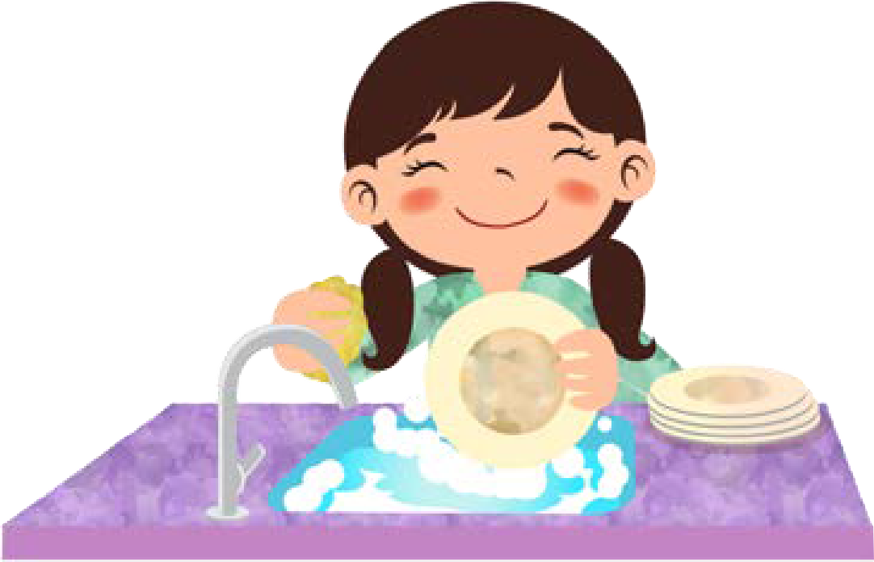
Furthermore, even under captivity, this little girl did not live in despair or in hopelessness, she continually searched for meaning of her life. She sought God’s strength and comfort; she also believed that God was more powerful and above all challenges, including leprosy.
(*Little servant girl works around the house and at times, stops to read the bible and pray.)
THE CARING LITTLE MAID (CONTINUED)
2 Kings 5:1-14
Even at a young age, some of you here might also experience some challenges which vary from one to another. At times, you might feel lonely or something like this little servant girl. Keep seeking God like this little servant girl did. And bear in mind that there is a purpose in every situation that God allows to happen to us. Our tears, hardships and sweat will not go to waste when we seek the true meaning out of every experience that we face. Through our challenges, it is possible that God is helping us to understand the needs of those who face the same challenges so that we could truly understand and become His instruments by channeling His character, love, care, and healing touch upon them.
Her character was perfumed with kindness, caring nature, and her ability to endure hardships, remained positive and continued to have a strong faith in God even with life’s less comfortable ingredients, she chose to bloom for Him.
(*Naaman and wife walk away from the stage leaving the servant girl alone, she kneels sadly and begins to cry for a while. Then wiping her tears, she gets up and walks to the area where there are things to work with. She begins working according to the sermon script: using clothes to wipe, use broom to sweep and mop the floor, cook, and dust furniture.)
*Naaman is sitting in the chair looking sad and then bends down to cry while the little maid enters the room. She observes him and walks toward him and pats on his shoulder. She then went to get a glass of water for him. Then they pretend to have a conversation and they freeze.)
There is no doubt that, being snatched and taken from her own family, the little servant girl must have felt sad and very lonely. She must be missing her loved ones at home, especially her parents, grandparents, brothers and sisters, or friends that she used to play with them. And remember that she was not taken to Naaman’s house as a special guest who would be served, but she was taken there as a maid or servant to serve in the house, under the direct order of Naaman’s wife (2 Kings 5:2). Out of her own will, she was forced to come to live in Naaman’s house and work whenever she was ordered to do so. She had to sweep the house, mop the floor, cook meals, and dust furniture around the house.
The little girl sensed the greater purpose beyond her chores and humble services. She noticed Naaman’s sadness and his suffering with Leprosy. Instead of having the same thought and judgement like other people that God was punishing him for his wrongdoing and maltreatment toward God’s people, she thought differently. Her heart filled with empathy, so she decided
At every meal, she had to serve food and juice to every member of Naaman’s household and often, there is no appreciation or positive feedback for her kind deeds. She could be very tired at times, but she continued to work diligently because she was different; she knew God and she was a godly child. She served people and “work heartily, as for the Lord and not for men,” (Colossians 3:23).

Slide 7
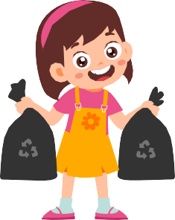
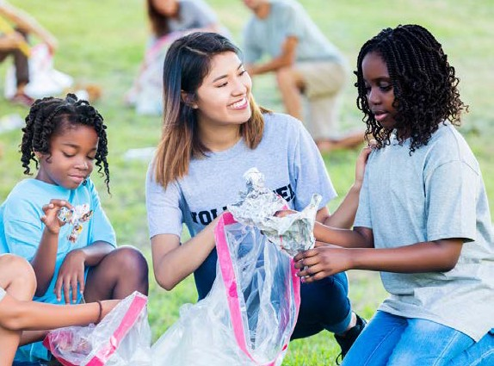
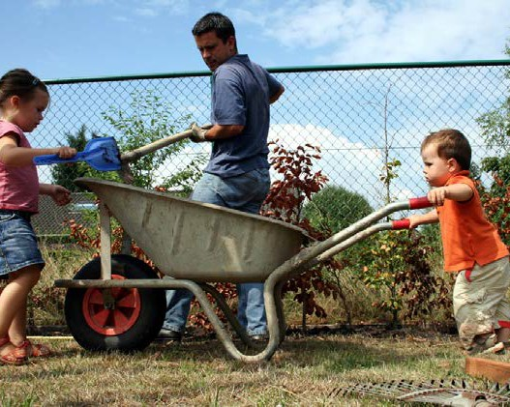
SUGGESTED ACTIVITIES FOR GLOBAL CHILDREN'S DAY
THE CARING LITTLE MAID (CONTINUED)
2 Kings 5:1-14
Clean parks with consenting adult
Donate clothes to salvation army or orphanage, Care packages
Select a friend and speak to them about God Conduct a 1-day VBS
Community outreach
Clean the church and the surrounding area Planting trees in the neighborhood
Mow the lawn and clean the house of an elderly Children’s hospital visit
Refugee camp visit (if possible)
Save environment by cleaning beaches
Save water sources by picking up trashes and waste thrown into rivers and canals
Simply just greet and smile kindly whenever you meet people along the way.
Any little kind deed counts toward Global Children’s Day.
to offer her help to make a difference in Naaman’s hopeless health condition. For this little servant girl, you might be wondering how she helped when she even received orders and could not help herself to be free from captivity. But she really did it, in her little but in a powerful way. As a result, she could channel God’s blessings and His healing miracles upon Naaman allowing countless people to witness God’s power and drawing many people towards Him.

